Slide 1
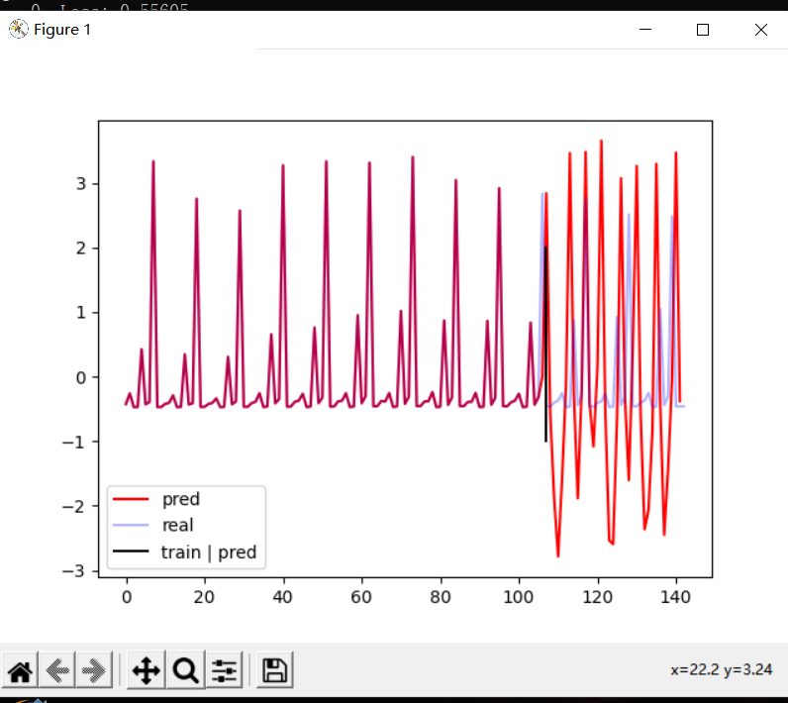
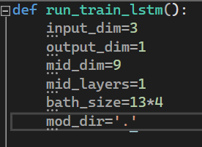
Guangyi Chen
Project Name:
Crime Predicting in the State of South Carolina
Problem:
Protecting citizens from the harm and violence is one of government's priorities. Using NLP and ML methods is an efficient and convenient method to help law enforcement get an in-depth idea of the crime trend . Crime predicting reports are critical information to the police force and can raise the efficiency of policing by allocating the right amount of police force to needed area , leading to a number of criminals arrested, cases cleared, and property recovered.
Dataset:
FBI-UCR online crime-data explorer
website::https://crime-data-explorer.app.cloud.gov/pages/downloads
Approach:
Named entity recognition is used to recognize proper nouns such as location, organization, and crime type in text and to classify them into given categories.
I put the crime data of the first 10 years and let LSTM predict the crime of the next 3 years, them we can first train the LSTM to predict the crime of the next month based on the data of the previous 10 years.After the training is completed,I let LSTM predict the crime trend of the next month based on the data of the first 10 years,take the predicted crime trend just output as input,and iteratively obtain the crime trend of the next three years.
Test Case :
Input-The crime info of crime type/crime location/crime number in different city .
Output-The predicted crime trend of specific type/location/city for the next three years.
Evaluation:
achieved an overall 7 out of 10 test cases of around 60% accuracy.

Slide 2
Comment:
Challenges faced:
Although LSTMs are a good model for predicting, they need to be trained many epochs to understand the patterns between the data and that is a very time-consuming .
Obviously, this analysis was performed using for pre-pandemic data, so crime forecasting will be performed at a later stage and compared with actual values in order to further evaluate this model’s efficiency.
Improvements:
Future steps for this project could be to search for indicators of causality or to filter data further, such as on holidays or weekends specifically, or even by nature of event. The purpose of this data is not to perfectly predict where and when a crime will occur, but to have a better understanding of how to prepare police force for rapid service to protect the people.

